Slide 1






Freelancer.com
+
Search me….
Sign up
Login
Welcome to xyz
The best freelancing
site to get jobs
Learn More…
© freelancer.com 2020

Slide 2

Freelancer.com
+
Search me….
Sign up
Login
I have been using xyz for 5 years now and I love it
Learn More…
© freelancer.com 2020

Slide 3


Freelancer.com
Search me….
Sign up
Login
Marketing
Research
Writing
Data Analysis
Programming
Vocational Training
Exams and Tests
Contact Us
Account
Xyz gives you the hands on skills and network you need
Learn More…
© freelancer.com 2020

Slide 4


Sign Up
Sign up to Start Earning
Username
Mobile Number
+254
Password
Confirm password
Next

Slide 5


Hello Paul207 Please verify it’s you.
We’ve sent a verification code to +254xxxxxxxx
Enter code…
Resend code
Wrong number?
Submit
© freelancer.com 2020

Slide 6


Login
Username:
Password:
Enter
© freelancer.com 2020

Slide 7








Freelancer.com
Get Started
Marketing
Research
Data Analysis
Writing
120.00
200.00
350.00
500.00
Begin
Unlock
Unlock
Unlock
© freelancer.com 2020

Slide 8










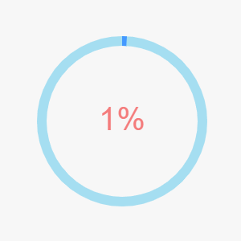
Freelancer.com
Marketing
Level 1
Level 2
Level 3
Finished!
start
start
© freelancer.com 2020

Slide 9

Freelancer.com
Level 1
Introduction to Marketing
Marketing refers to activities a company undertakes to promote the buying or selling of a product or service. Marketing includes advertising, selling, and delivering products to consumers or other businesses. Some marketing is done by affiliates on behalf of a company.
Professionals who work in a corporation's marketing and promotion departments seek to get the attention of key potential audiences through ad…
Continue…
Quit
© freelancer.com 2020

Slide 10
Accounts
Price Table
$10/month
$200/month
$500/month
Buy now.
Buy now.
Buy now
Validity | 1 month | 6 month | 1 year
Research
Writing
Data Analysis
Programming
Vocational Training
Exams and Tests
Marketing and Networking
© freelancer.com 2020

Slide 11



Back
My Account
Username
My Profile
Paul207
My Services
Phone
+254xxxxxxxx
Billing
Last Seen
My Rating
Edit profile image
2 Days Ago
Save
Logout
© freelancer.com 2020
Terms and conditions

Slide 12
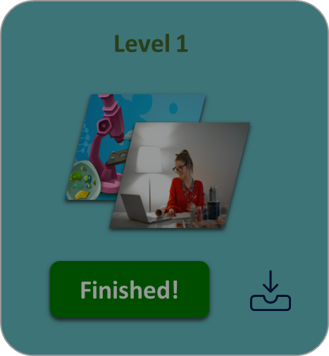
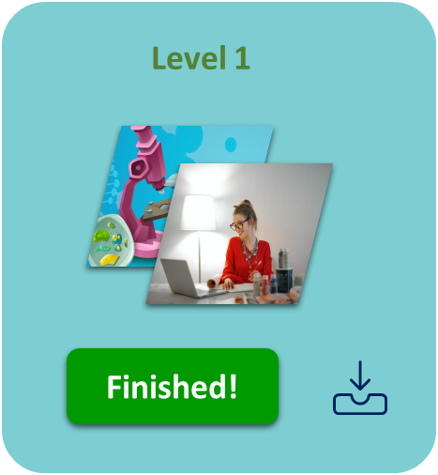
Back
My Account
Package Name
My Profile
Ml1 Intro to Marketing
My Services
Duration
36 Hours
Billing
Points Earned
My Rating
569
Show More…
Logout
© freelancer.com 2020
Terms and conditions

Slide 13

Back
My Account
Status
Balance
My Profile
199.04
My Services
Pending Pays
0
Billing
Completed Pays
199.04
Active
My Rating
67
Deposit
Logout
© freelancer.com 2020
Terms and conditions

Slide 14


Back
My Account
Levels Completed
My Profile
146
My Services
Pending
0
Billing
Revoked
My Rating
File Description
17
Upload
Logout
© freelancer.com 2020
Terms and conditions

Slide 15




Freelancer.com
Contact Us
Email:
Subject:
Message
07123456789
Freelancer.com
Freelancer.com
Freelancer.com
© freelancer.com 2020

